Slide 1
World electricity
A comprihensive Analysis

Slide 2
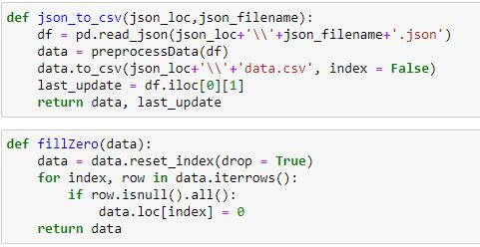
Data processing through python

Slide 3
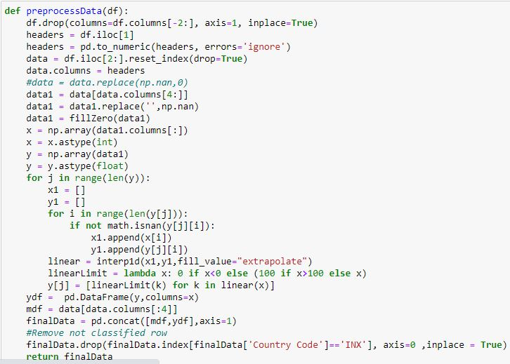
Data cleaning, interpolation,

Slide 4
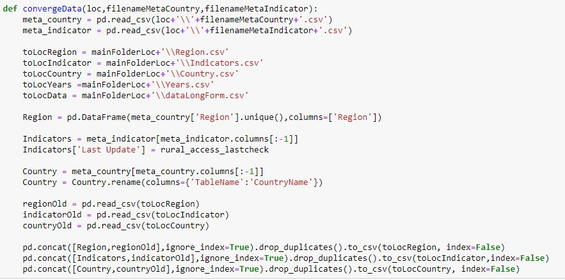
Cleaning and aggregating meta data

Slide 5
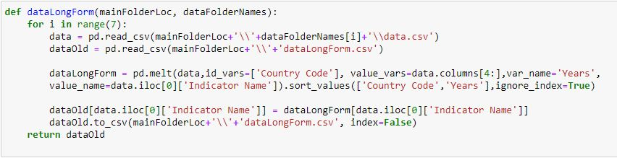
Changing and aggregating data from wide to long form

Slide 6
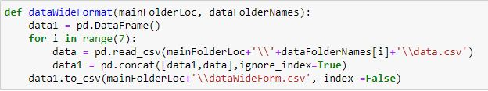
Aggregating data in wide form

Slide 7
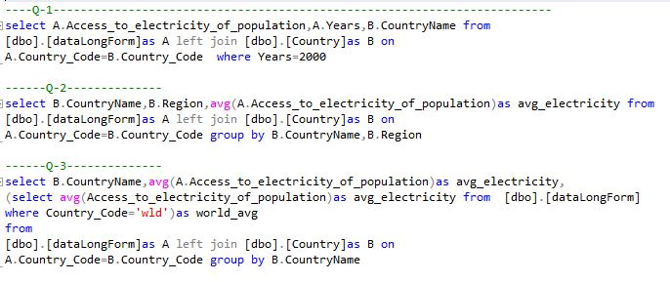
Using sql to solve questions

Slide 8
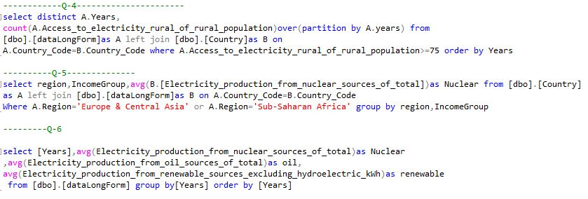
Using sql to solve questions

Slide 9
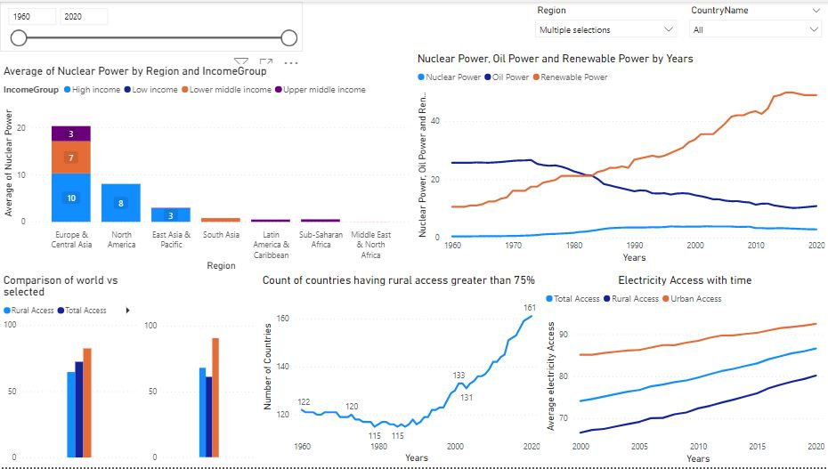
Powerbi dashboard

Slide 10
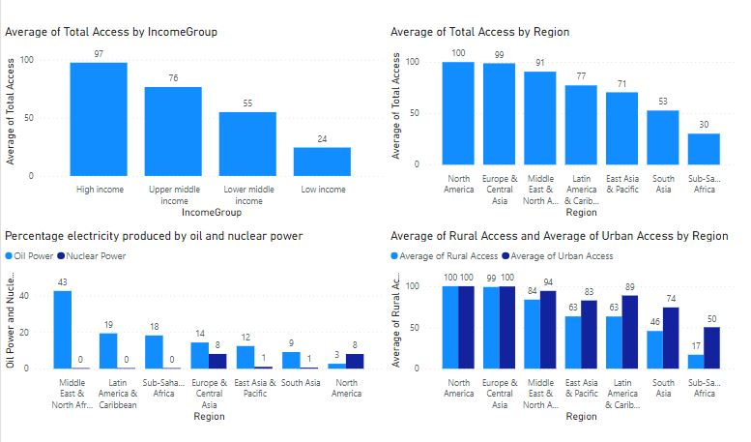
Analysis

Slide 11
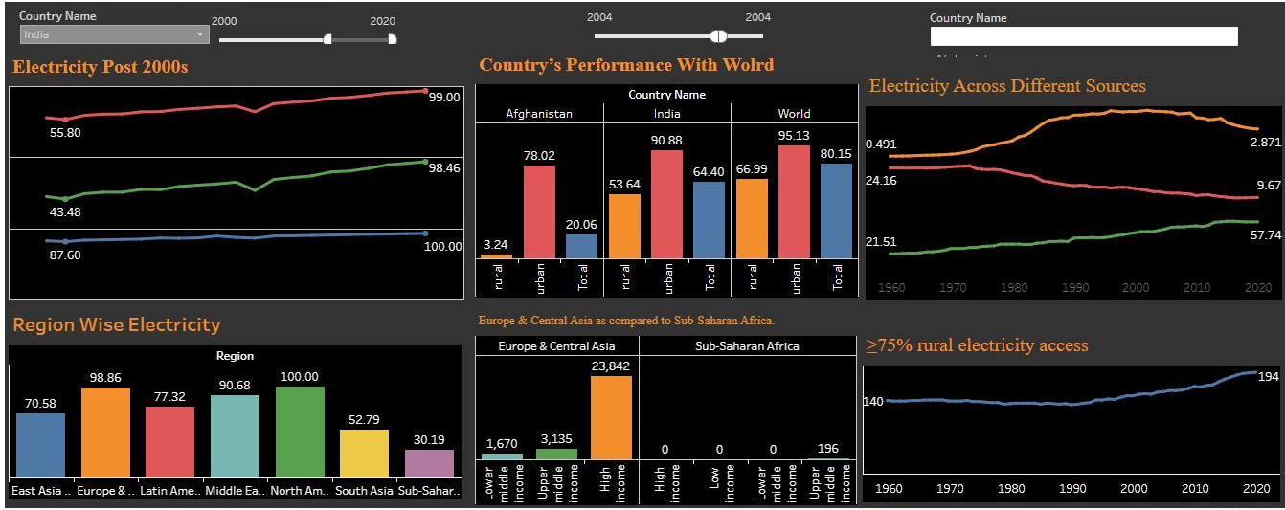
Tableau dashboard

Slide 12
Conclusions
Electricity Access in countries were directly related to income classification.
With time use of renewable sources has increased and oil has decreased.
With time use of nuclear power remained stable.
North America was the leading reason in access and generation of electricity with nuclear power.

